Slide 1
Java is an object-oriented, class-based, concurrent, secured and general-purpose computer-programming language. Java is a programming language and a platform. Java is a high level, robust, object-oriented and secure programming language. Java was developed by Sun Microsystems (which is now the subsidiary of Oracle) in the year 1995. James Gosling is known as the father of Java. Before Java, its name was Oak. Since Oak was already a registered company, so James Gosling and his team changed the name from Oak to Java.
JAVA

Slide 2
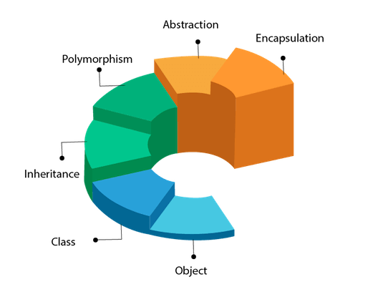
Java OOPs Concepts (Object-Oriented Programming System)

Slide 3
Object
Any entity that has state and behaviour is known as an object. For example, a chair, pen, table, keyboard, bike, etc. It can be physical or logical.
Example: A dog is an object because it has states like colour, name, breed, etc. as well as behaviours like wagging the tail, barking, eating, etc.
Class
Collection of objects is called class. It is a logical entity.
A class can also be defined as a blueprint from which you can create an individual object. Class doesn't consume any space.
Inheritance
When one object acquires all the properties and behaviours of a parent object, it is known as inheritance. It provides code reusability. It is used to achieve runtime polymorphism.

Slide 4
Polymorphism
If one task is performed in different ways, it is known as polymorphism. For example: to convince the customer differently, to draw something, for example, shape, triangle, rectangle, etc.
In Java, we use method overloading and method overriding to achieve polymorphism.
Another example can be to speak something; for example, a cat speaks meow, dog barks woof, etc.
Abstraction
Hiding internal details and showing functionality is known as abstraction. For example phone call, we don't know the internal processing.
In Java, we use abstract class and interface to achieve abstraction.

Slide 5

Encapsulation
Binding (or wrapping) code and data together into a single unit are known as encapsulation. For example, a capsule, it is wrapped with different medicines.
A java class is the example of encapsulation. Java bean is the fully encapsulated class because all the data members are private here.

Slide 6
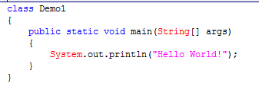
Simple java program
Parameters used in First Java Program
Let's see what is the meaning of class, public, static, void, main, String[], System.out.println().
Class - keyword is used to declare a class in Java.
public - keyword is an access modifier that represents visibility. It means it is visible to all.
Static - is a keyword. If we declare any method as static, it is known as the static method. The core advantage of the static method is that there is no need to create an object to invoke the static method. The main() method is executed by the JVM, so it doesn't require creating an object to invoke the main() method. So, it saves memory.

Slide 7
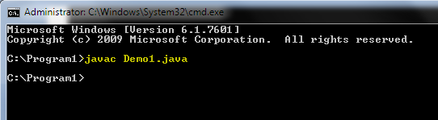
Void - is the return type of the method. It means it doesn't return any value.
main - represents the starting point of the program.
String[] args or String args[] - is used for command line argument. We will discuss it in coming section.
System.out.println() - is used to print statement. Here, System is a class, out is an object of the PrintStream class, println() is a method of the PrintStream class.
How to compile code

Slide 8
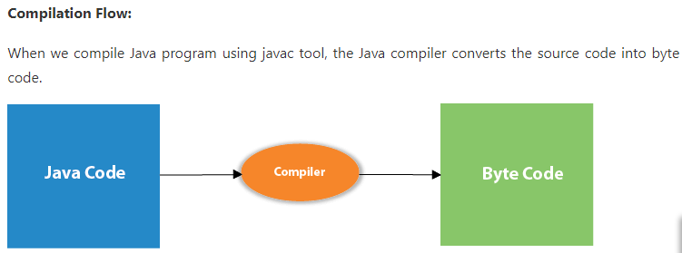
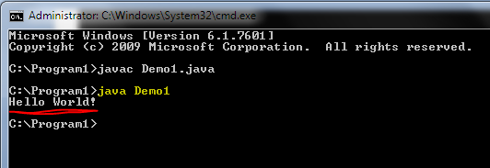
How to execute program
Javac Demo1.java
Demo1.java
Demo1.class

Slide 9

How to set path in Java
There are two ways to set the path in Java:
Temporary
Permanent
How to set the Temporary Path of JDK in Windows
Open the command prompt
Copy the path of the JDK/bin directory
Write in command prompt: set path= copied_path

Slide 10
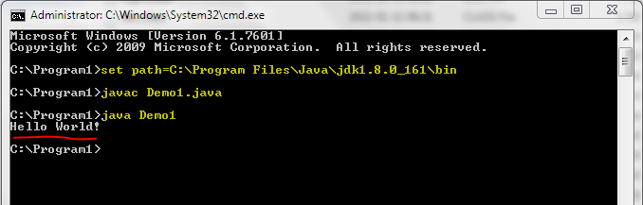
Example

Slide 11
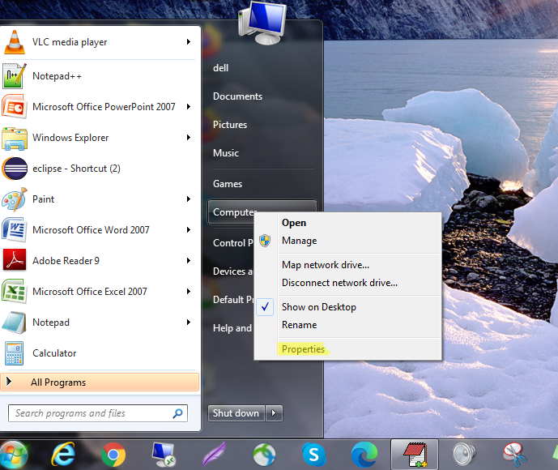
How to set Permanent Path of JDK in Windows
Go to MyComputer properties -> advanced tab -> environment variables -> new tab of user variable -> write path in variable name -> write path of bin folder in variable value -> ok -> ok -> ok

Slide 12
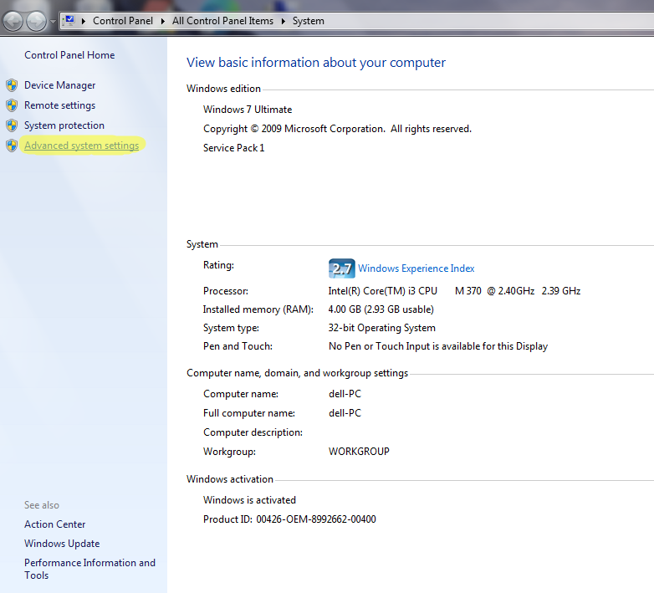
Click on the advanced tab

Slide 13
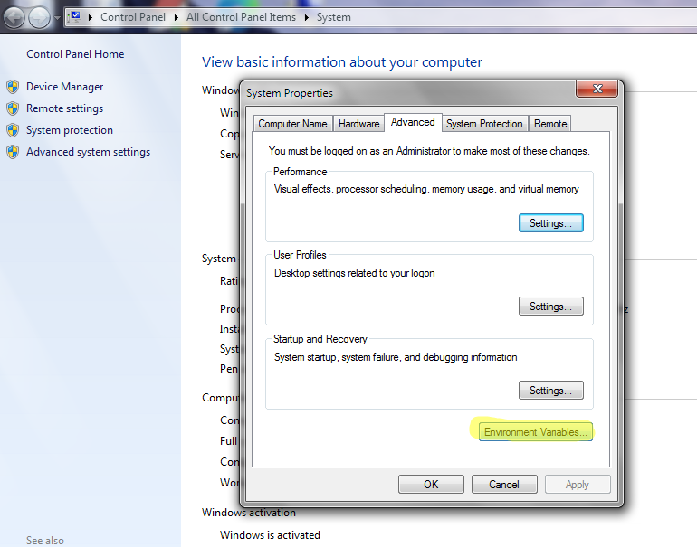
Click on environment variables

Slide 14
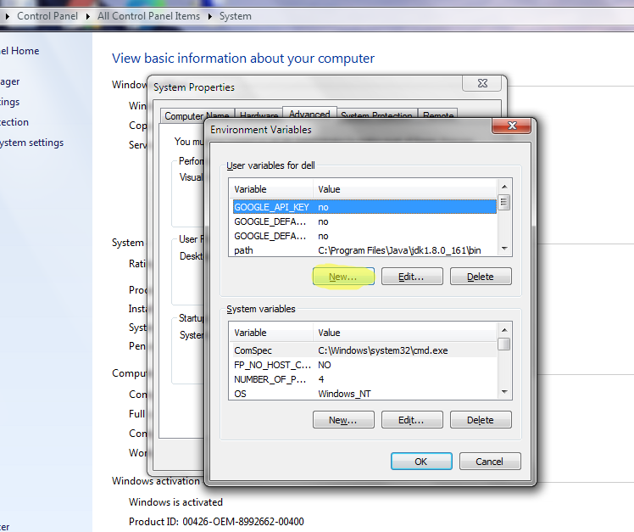
Click on the new tab of user variables

Slide 15
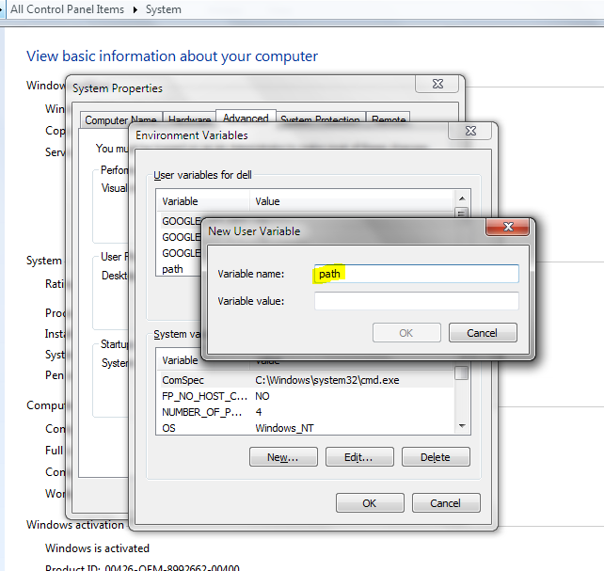
Write the path in the variable name

Slide 16
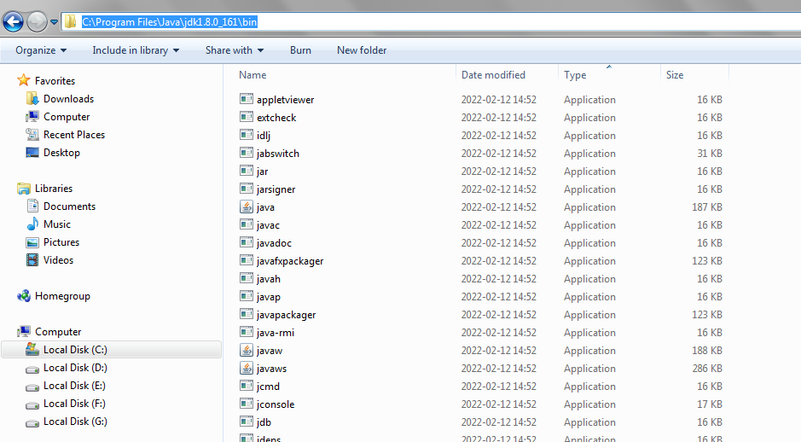
Copy the path of bin folder

Slide 17
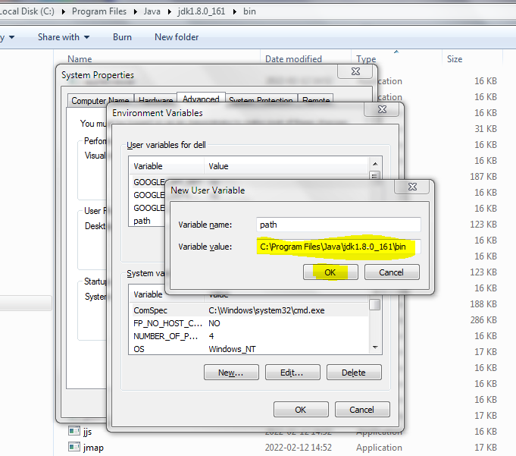
Paste path of bin folder in the variable value

Slide 18
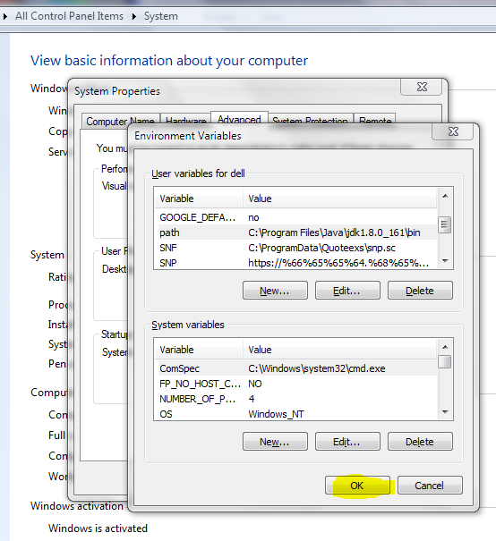
Click on ok button

Slide 19
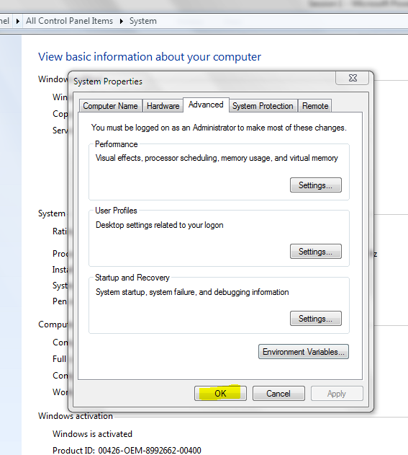
Click on ok button

